Slide 1
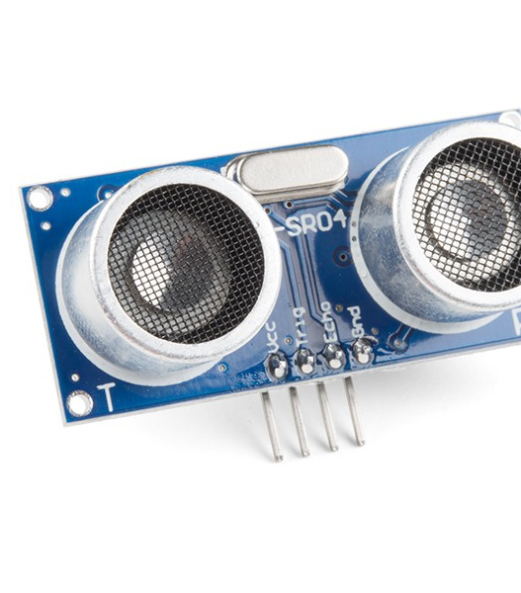
Sprint 3
Ultrasonic Sensor

Slide 2
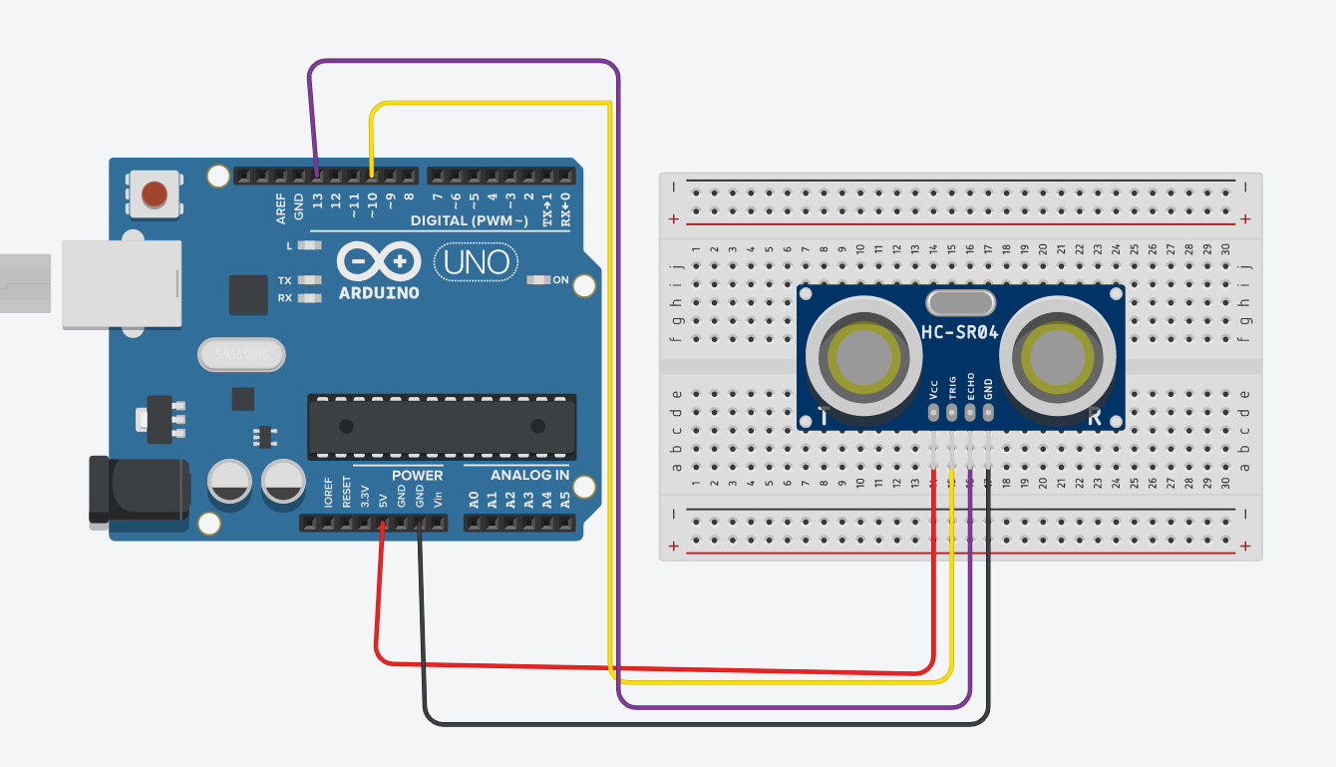
Circuit Diagram

Slide 3
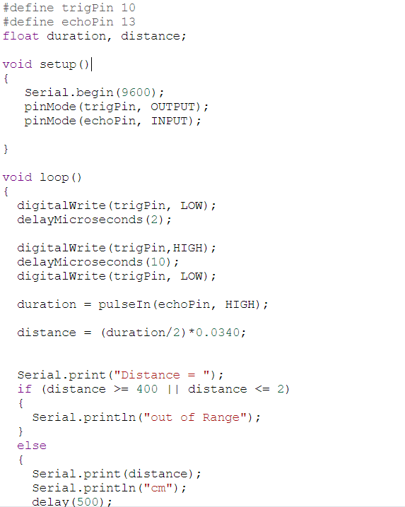
CODE

Slide 4
Working Principle
Time Delation between Transmitted and Received Ultrasonic signals is used to calculate the distance between sensor and body.
Longer time Delay = Longer Distance
Shorter time Delay = Shorter Distance
Distance measured in cm

Slide 5
How to Calculate Distance
High Level Time = t = Duration of time from sending to returning
Speed of Sound = c
Distance Measured= D
D = t/2*c
Speed of Sound = 343 m/sec

Slide 6
Summary and Environmental Effects
Sensors use sound waves for its ranging
Speed of sound is influenced by number of environmental parameters
It send sound pulses toward object and receive echo signals in reflection
Speed of sound increases with the increase in moisture of air so its effect on measuring distance
Environmental parameters that effect the measurements are Temperature, Relative Humidity, Change in Pressure, Change in concentration of Carbon Dioxide Gas.

